Slide 1
SwaCom: Swarm Computing framework for image-sensing applications
By Arpita Ambavane, Sai Akhil Teja, Tushar Gautam

Slide 2
Image-sensing applications collaborating locally using distributed computing framework
Notes:
Image Sensing Applications Surveillance Systems: Face recognition, Motion Detection, Scene Detection, Crowd Monitoring and management applications. Why locally? - Current deployments require connectivity to either cloud or edge. Remote devices might have poor or no connectivity. Distributed Framework? To collaborate with peer devices and manage the membership, work distribution etc.

Slide 3
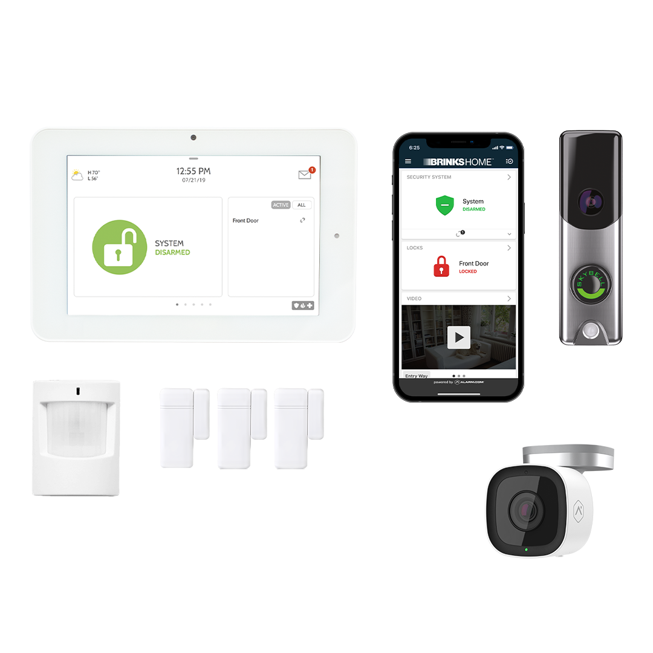
Encouraging trends in camera systems
Notes:
CCTV has been around for a long time … Businesses and public places…Today avg smartphones more powerful than them…
IN smartcameras you won’t have to sort through hours of footage to find what you’re looking for
Smart cameras eliminate this problem — and the integration of motion-detection is the key. Motion detectors allow the smart camera to record only when something is moving. If nothing in particular is going on, nothing will be recorded. Of course, this functionality is optional
CCTV - recording footage locally on hard drive – size limitation — can be lost if anything happens–
to run advanced AI workloads at the edge or on the endpoint camera itself, there is a need for higher performance processing, to address applications such as high-definition imaging to enhanced security.
Frames per second, or fps, are the simple act of measuring how many video frames the surveillance camera captures per second of video.
Why we chose camera system?
Hardware
Communication
Examples : ARMs, ….Modern CPU architecture in Smart Cameras
Arm based 64-bit CPU architectures [5] come with enhanced register support and larger memory maps. The increase in both number and width of registers mean that larger data sets can be processed with a reduced number of memory accesses, resulting in faster data processing.

Slide 4
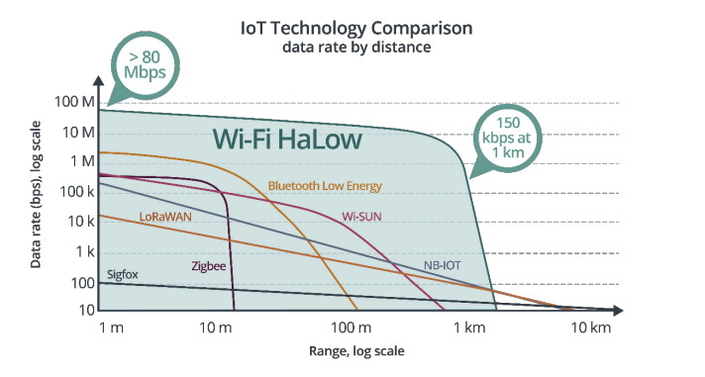
Encouraging trends in communication technologies

Slide 5
Challenges
Device Heterogeneity
Network Conditions
Notes:
Device heterogeneity: Power - Low power devices, Hardware stuff like ISA, cores, processors.
Network Conditions: Intermittent - connection may not be continuous, Low network or no network.

Slide 6
Related Work
Cloud-Only System
Edge Computing
Mobile-Cloud Computing
The Atos Approach
Swing - Swarm Computing for Mobile

Slide 7
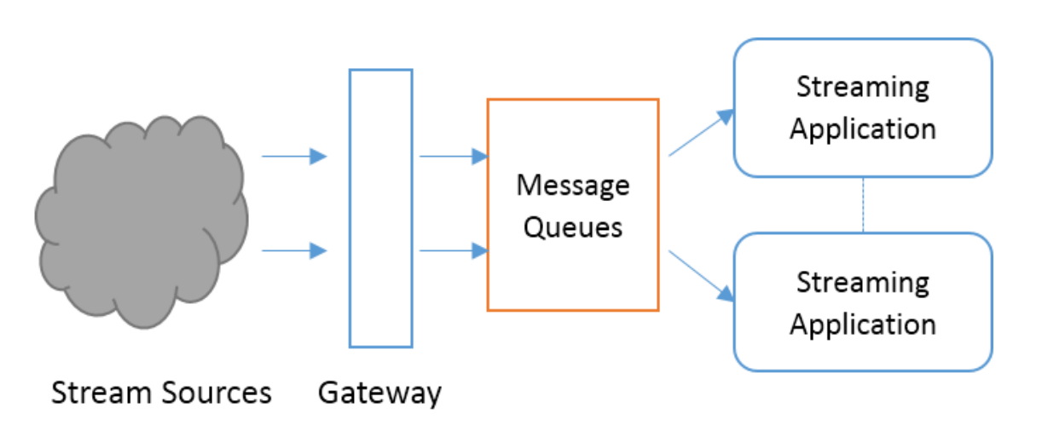
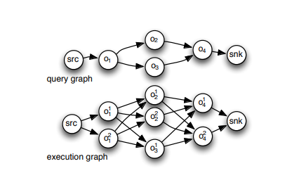
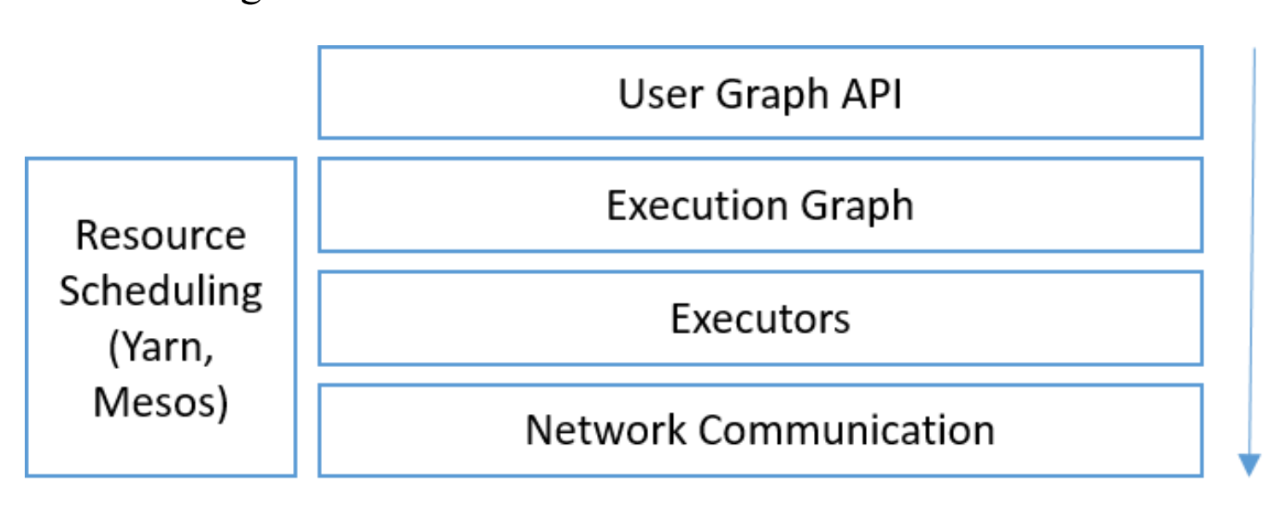
Related Work
Distributed Stream Processing Framework (DSPF)

Slide 8
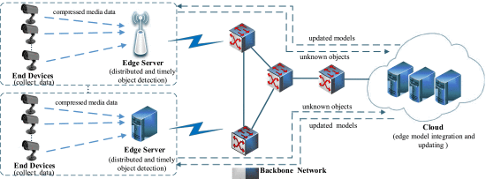
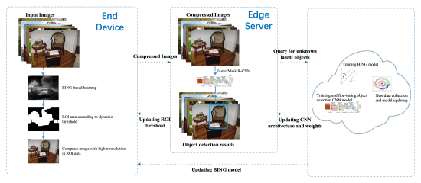
Related Work
Distributed and Efficient Object Detection via Interaction Among Devices, Edge, and Cloud
Notes:
The end device layer is responsible for compressing the real-time captured pictures - lightweight region of interest (RoI) based image compression
RoI compression means the background of the image is highly compressed and the accuracy of the RoI is kept and this approach was named as BING
based RoI Extraction (BRE).
Cloud - dynamically update local object detection on edge servers and BRE methods on end devices , then cloud collect data from edge servers and incorporate this knowledge to update the model
Designing an object detection model for lightweight end devices for extracting Feature maps are challenging.
This was handled by using the compressed raw image instead of feature maps for object detection at the edge side in the edge architecture

Slide 9
Related Work
Amazon SageMaker
A library named SageMaker Python SDK - to train and deploy models using popular deep learning frameworks and algorithms.
Apache Spark - included in a set of prebuilt Docker images provided by ASM which are required to run distributed data processing jobs.
SageMakerNeo auto optimizes any trained model with no loss of accuracy.
Pytorch RPC
Distributed RPC framework provides mechanisms for multi-machine model training through a set of primitives to allow for remote communication, and a higher-level API to automatically differentiate models split across several machines.
RPC API is used to delegating part of models to different nodes. No scheduling is mentioned.

Slide 10
Design Requirements
Low resource footprints
Handle camera device failures
Handle streaming data
Job scheduling based on heuristics such as resource utilization, data upload rate, historical average rate of job completion, etc.
Most of the related work we surveyed have architecture designed on streaming frameworks like Kafka, RabbitMQ etc. Such frameworks are resource heavy.

Slide 11
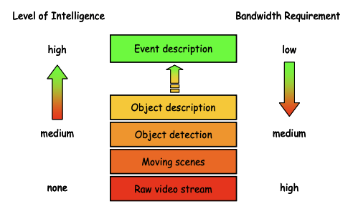
Design Proposal
Level of Intelligence vs Bandwidth Requirement

Slide 12
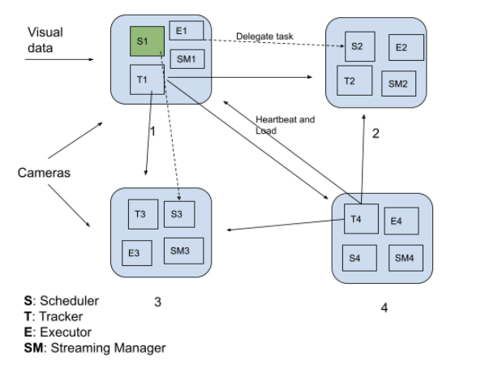
Design Proposal
Tracker
Scheduler
Streaming Manager
Executor
Action Manager

Slide 13
Tracker
Receives and broadcasts heartbeat periodically (configurable).
Group membership protocol to manage devices joining or failure.
Piggybacks load metrics along with heartbeat message.
Maintains resource utilization for each peer.

Slide 14
Scheduler
Runs as an independent process on each device and is responsible for scheduling job created by its own device only. No global scheduler.
Requests Tracker on its local device to get resource availability for all peers.
Provides list of peer IPs to Streaming Manager to distribute the data.
Scheduling based on:
Least loaded.
Good upload rate.
Avg rate of job completion time for each peer.
Can be extended with scheduler API.

Slide 15
Streaming Manager
Responsible for streaming data to the executors and creating a new Job ID (device_id, #stream_seq).
Reports executor failure to scheduler.
Requests executor list from Scheduler before starting a new job or requesting upon executor failure.
Maintains a buffer of a few seconds (config) to resend data in case of executor failure.
Stops streaming to the executors upon receiving processing completion signal from Action Manager.

Slide 16
Executor
Runs as an independent process on each device.
Isolated environment for executing jobs.
Receives data from Streaming Manager and delivers with Reliable FIFO ordering.
Isolation provided by containerization using Linux Container (LXC) or Docker.
Well defined execution environment with container image.
Sends result back to source Action Manager.

Slide 17
Action Manager
Runs as an independent process on each device.
Receives results from all executors for a given Job ID.
Upon receiving majority the executor results, it can take pre-defined actions such as sending PagerDuty alerts or triggering siren alarm.
Well-defined action module can support addition of user-defined actions to enable Action Manager support various action types.

Slide 18
Questions?

Slide 19
Thank you!

